Slide 1
Reproducible Workflows in R
Gabriel Rosenfeld, PhD
Data Scientist
Bioinformatics and Computational Biosciences Branch

Slide 2
Bioinformatics and Computational Biosciences Branch (BCBB)
My background: Data Scientist in the Bioinformatics and Computational Biosciences Branch in the Office of Cyber Infrastructure and Computational Biology
Check us out: https://bioinformatics.niaid.nih.gov/researchcollaborationandsupport
Do you conduct research involving genomics (clinical, meta and microbial), imaging, data science and biostatistics, or structural biology?
We offer collaboration opportunities to address research questions at no direct cost to the NIAID research community and collaborators

Slide 3
Why learn reproducible workflows in R?
More efficient once the workflow approach has been mastered:
Leave a project and pick it up months later
Reproduce current results
Skip previous steps and concentrate on current parts of the analysis
Do it at scale (big data, complex processing)
Reproducibility crisis: it’s hard to reproduce and replicate many biomedical studies (Replication crisis – Wikipedia)
While not guaranteeing replicability, ensures reproducibility on the specific study/data pipeline used

Slide 4
What is a reproducible workflow in R?
Reproducible workflow may have a nebulous meaning depending upon the R user defining it:
Is it an R markdown document with all the analysis steps in literate programming workflow?
Is it a set of scripts that can be run sequentially via an IDE or command line?
Is it a project folder with a readme, scripts, associated data?
For today’s tutorial, I define a reproducible workflow as a set of computational steps with associated code and data that can be run reproducibly by two different users to achieve an identical result

Slide 5
How does one use reproducible workflows in R?
Lots of potential options…CRAN Task View: Reproducible Research (r-project.org)
I recommend the targets R package, which focuses on “Make”-like declarative workflows (we’ll use it today):
R and functional programming focused
Works well with projects: typical of biomedical research
Data analysis recipe and dependencies (from “Make”)

Slide 6
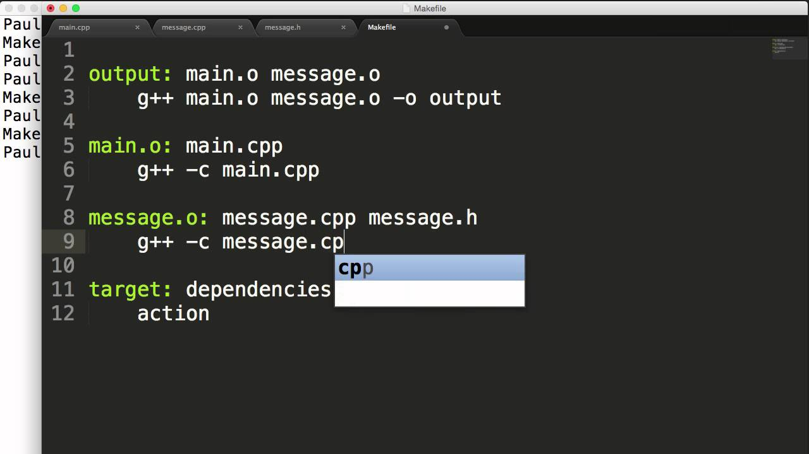
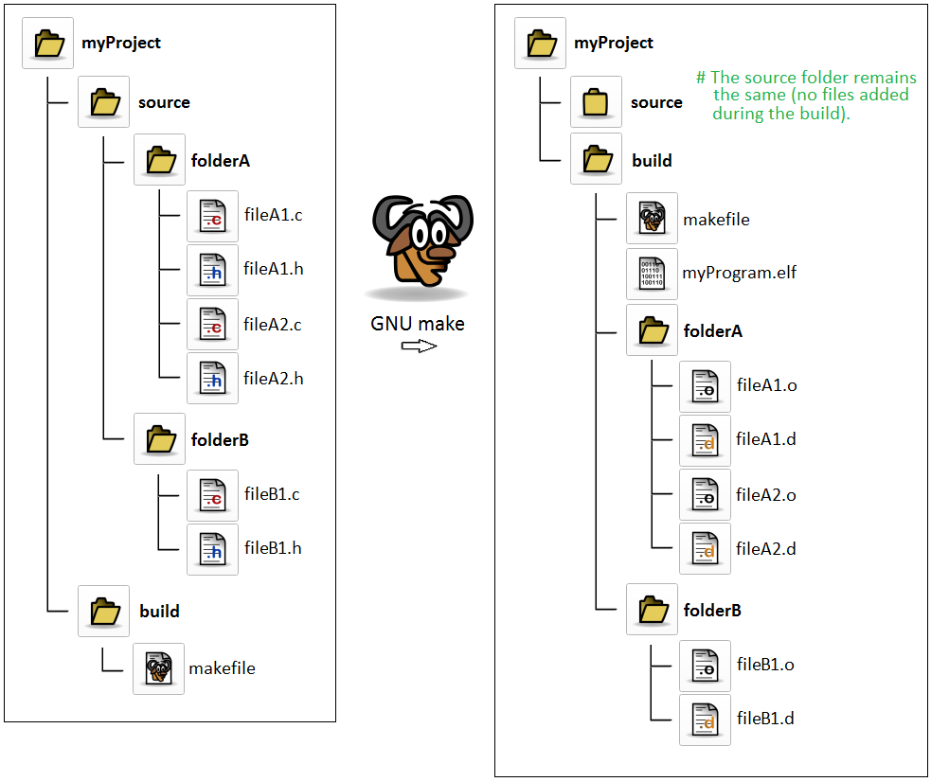
What is Make?
https://www.youtube.com/watch?v=_r7i5X0rXJk&ab_channel=PaulProgramming
Make is a program that takes an input called a “Makefile” that is a recipe for how to work with a series of executables and other files of a computer program. It keeps track of dependencies and only runs steps that need to be rerun during the development of the program.
https://www.gnu.org/software/make/
https://stackoverflow.com/questions/39015453/building-c-program-out-of-source-tree-with-gnu-make

Slide 7
What is targets?
An R package to allow an R analyst to maintain a reproducible workflow for a specific analysis they are working on:
Incorporates “makefile” concept with _targets.R file containing steps in the recipe of the data analysis
Interprets recipe to determine the order of steps (e.g., data loading, processing, visualizations, etc.)
Reruns only the necessary steps of the analysis (e.g., if working on visualization, then only visualization steps are rerun)
Developed by Will Landau, an Eli Lilly scientist, after seeing a need for an R package but not finding one with all required features
https://docs.ropensci.org/targets/

Slide 8
Specific features of targets R package
Part of a suite of R packages that is evolving to handle common analysis tasks (e.g., ML, AI, Bayesian, etc.): (https://wlandau.github.io/targetopia/packages.html)
Extremely helpful documentation and examples to get started (https://books.ropensci.org/targets/)
Functional programming style (e.g., recipe step is a function returning results for use in subsequent steps)
Useful debugging features to identify errors or other issues (https://books.ropensci.org/targets/debugging.html)
Well-suited for project-based analysis and structure
Set up to allow analysis to scale:
Static and dynamic branching execute a common function (e.g., a model) across data subsets (https://books.ropensci.org/targets/dynamic.html)
Support for high-performance computing (https://books.ropensci.org/targets/hpc.html)
Facilitates collaboration when used with other data scientists and tools like code versioning

Slide 9
Targets project setup with tflow and renv
Targets has a whole chapter on how to use it within projects (https://books.ropensci.org/targets/projects.html)
I recommend tflow (https://github.com/MilesMcBain/tflow) and we’ll use today to set up the project
I also recommend renv to set up a project library (https://rstudio.github.io/renv/articles/renv.html)
Benefits of tflow:
GitHub install with dependencies installs targets and other key R packages
Functions that can set up a consistent project structure
fnmate to quickly add new functions to represent each step in your analysis as R files
conflicted to detect conflicts between packages
Updates project environment to prevent unintended use of logical vectors

Slide 10
Where to find R and RStudio if you want to use targets for your analysis?
Within NIAID, you can use self-service or on the LOCUS HPC cluster:
Windows Software Center: https://inside.niaid.nih.gov/it-equipment/installing-scientific-software-using-software-center
Mac self-service: https://inside.niaid.nih.gov/it-equipment/installing-scientific-software-mac-self-service
NIAID Locus: https://inside.niaid.nih.gov/media/locus-high-performance-computing-hpc-support-portal
Within NIH, you can use the Biowulf HPC cluster: https://hpc.nih.gov/
Download and install R and Rstudio:
R: https://www.r-project.org/
Rstudio: https://www.rstudio.com/

Slide 11
Tutorial overview
I will provide a tutorial of using targets for reproducible workflows during the next part of the webinar
Next part of presentation covers the pre-requisites and set-up if you would like to follow along
I will keep the tutorial moving at a steady pace, so we complete it
If you only want to listen or if you get stuck, no worries…
You can go back to the material and complete later
Goal today is to introduce the material and demonstrate its use

Slide 12
Tutorial overview
Our goal today will be to search NCBI for a collection of related DNA sequences in the PopSet database, download the data, and visualize relationships
We will use a specific dataset of Mycobacteria with partial cds of the hsp65 gene (https://www.ncbi.nlm.nih.gov/popset/?term=1847589303%5BUID%5D)
Key objectives:
Create a targets workflow project on your computer
Set up the project
Downloading, wrangling, and visualizing the data

Slide 13
Pre-requisites for tutorial
You will need to have R and RStudio installed, and the course materials downloaded from GitHub
R version 4.2.1+ (https://cran.r-project.org/)
RStudio (https://www.rstudio.com/products/rstudio/)
Location of course materials: https://github.com/niaid/Data-Science-with-R
Specific course is reproducible_workflows_r folder
If within NIAID, consider self-service for R and Rstudio install:
Windows self-service: https://inside.niaid.nih.gov/it-equipment/installing-scientific-software-using-software-center
Mac self-service: https://inside.niaid.nih.gov/it-equipment/installing-scientific-software-mac-self-service
We will be using the R markdown file (reproducible_workflows_r.Rmd)
There are also detailed instructions in the .Rmd file for the initial required software and set up

Slide 14
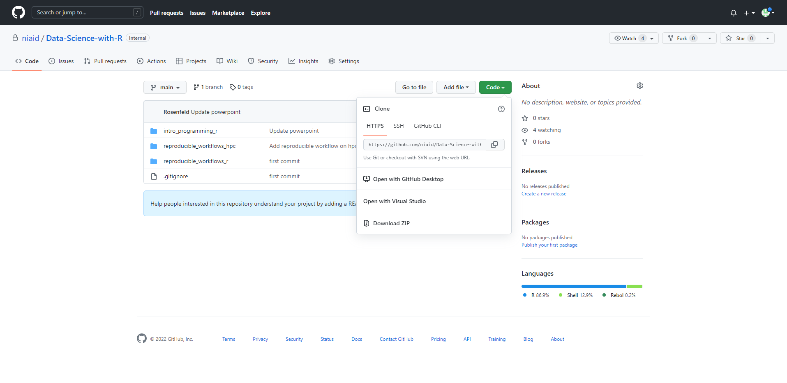
Tutorial Set Up
https://github.com/niaid/Data-Science-with-R

Slide 15
Tutorial Set Up
Unzip the downloaded file in your downloads folder
Open the subfolder “reproducible_workflows_r” and then the “reproducible_workflows_r.Rproj” file
If RStudio is installed, then this should open the project in RStudio

Slide 16
Tutorial Set Up
While installing packages during tutorial, you will need to be off any VPN as this may interfere
In the RStudio console (bottom left tab), add the following code below and then hit enter:
install.packages(“renv”)
Now add the following code to the console and hit enter after each:
renv::restore()
Write “y” to any prompts
Open the “reproducible_workflows_r.Rmd” file, which should pop up in the upper left quadrant of RStudio

